Slide 1
Setting Up Multi-factor Authentication (MFA) Application
Training Together

Slide 2
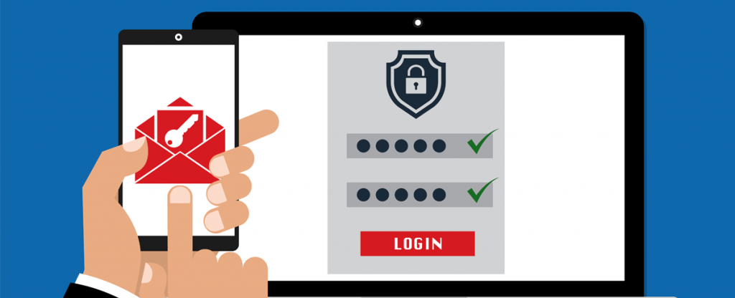
What is Multi-factor Authentication?
Multi-factor authentication refers to the pieces of information you need to provide to gain access to our employee-facing services outside the DTA network.
Its an added layer of security making it harder for an account to be accessed by outside sources even if a password is compromised. This is essential in ensuring the safety and security of our clients Personally Identifiable Information.
Training Together

Slide 3
Multi-Factor Authentication Set Up: General Steps
Download the Microsoft Authenticator app onto your smartphone.
Log in to the Centrify webpage.
Scan the OATH OTP Client QR code with your Microsoft Authenticator app.
Enter the 6 digit verification code that is generated in the app and select “Verify.”
Training Together

Slide 4
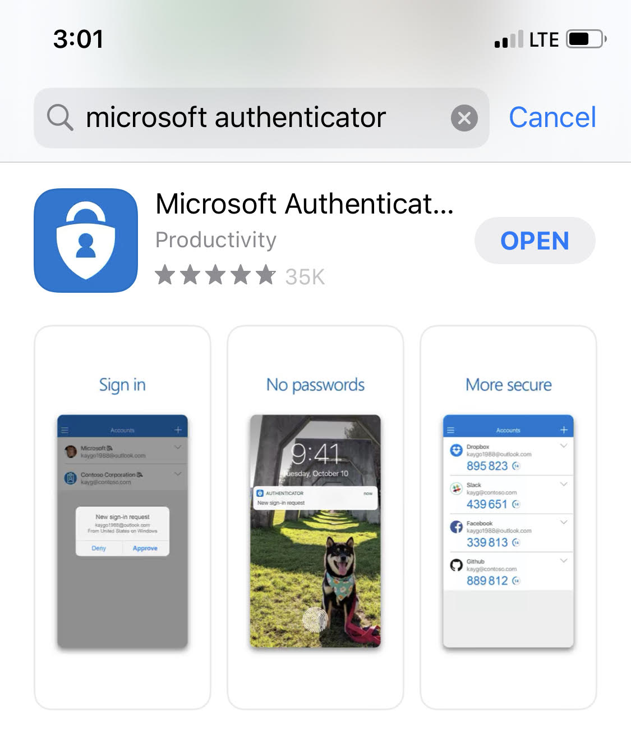
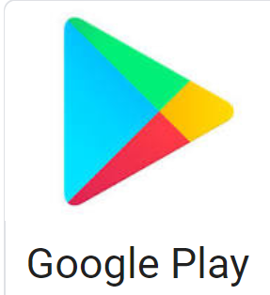
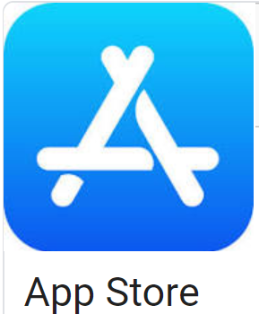
How Do I Set Up MFA?
Step 1: Download the Microsoft Authenticator App onto your smartphone.
Access your App store or Google Play store.
GET
Search for Microsoft Authenticator.
Training Together
This Photo by Unknown Author is licensed under CC BY-SA

Slide 5
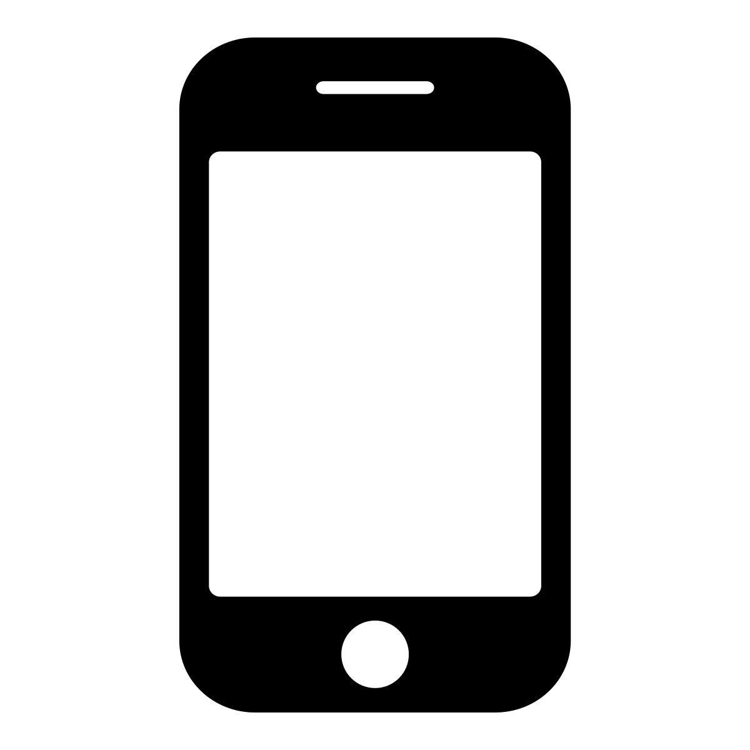
How Do I Set Up MFA?
Step 1: Download the Microsoft Authenticator App onto your smartphone.
* Android Users may need to download the “idaptive” application if prompted*
Training Together
This Photo by Unknown Author is licensed under CC BY-SA

Slide 6
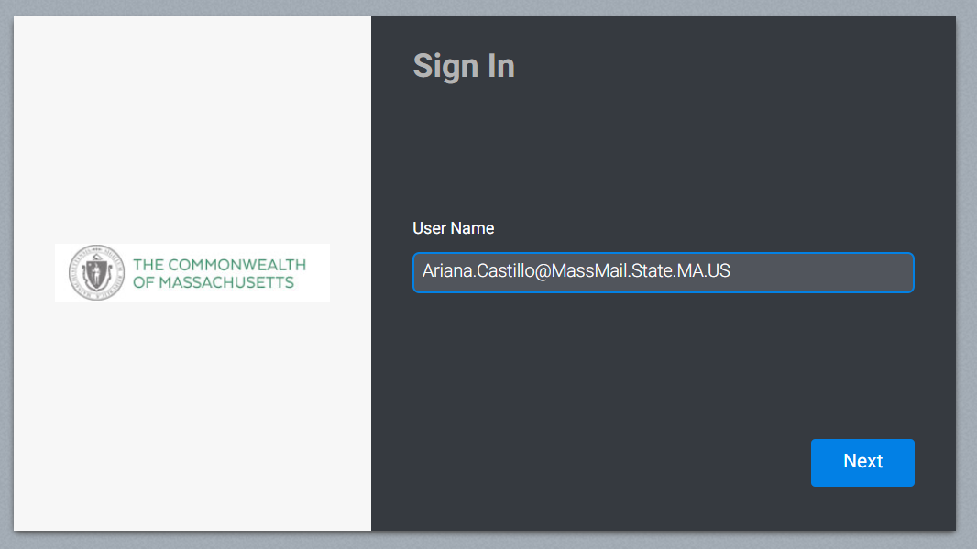
How Do I Set Up MFA?
Step 2: Log In to Centrify using your UPN and Password
Quick Tip: Your password is the same password you use to log in to your
work computer.
Yourname
*For further assistance logging in to Centrify, refer to the “Finding your User Principal Name (UPN) and Logging into Centrify” guide.
Training Together

Slide 7
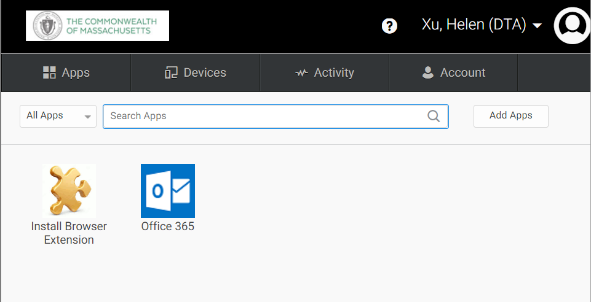
How Do I Set Up MFA?
Step 2 Continued: Select Account.
Training Together

Slide 8
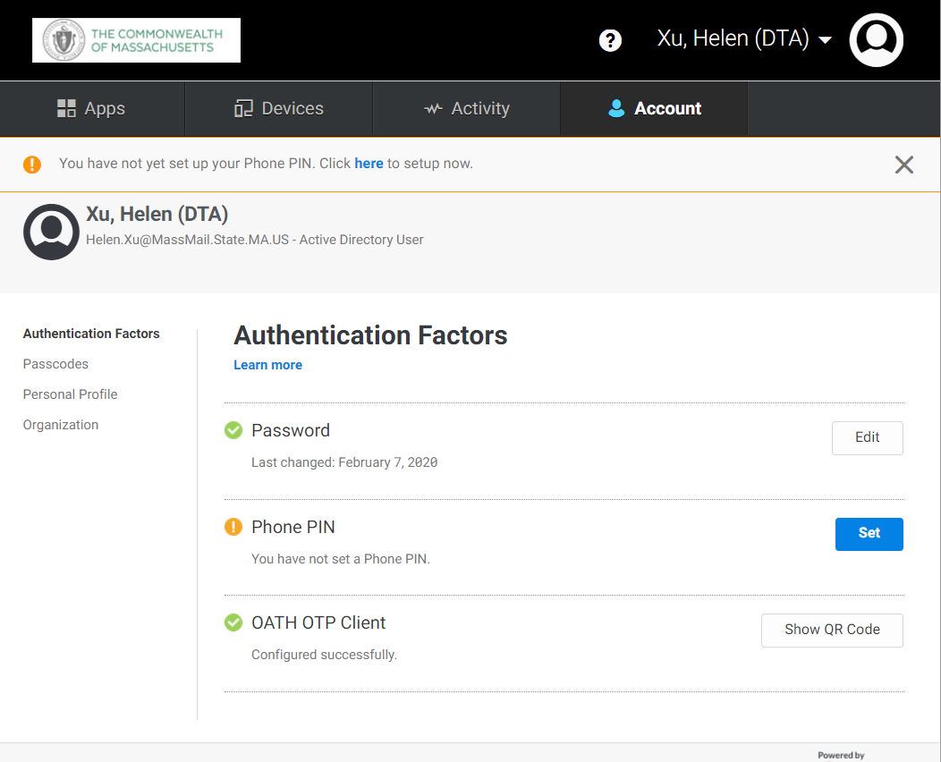
How Do I Set Up MFA?
Step 3: For this step, you will need the Centrify webpage open on your computer and you will need your smartphone readily available.
Training Together

Slide 9
How Do I Set Up MFA?
Step 3: Select Authentication Factors and click “Show QR Code” under OATH OTP Client.
Click “Show QR Code”
Training Together

Slide 10
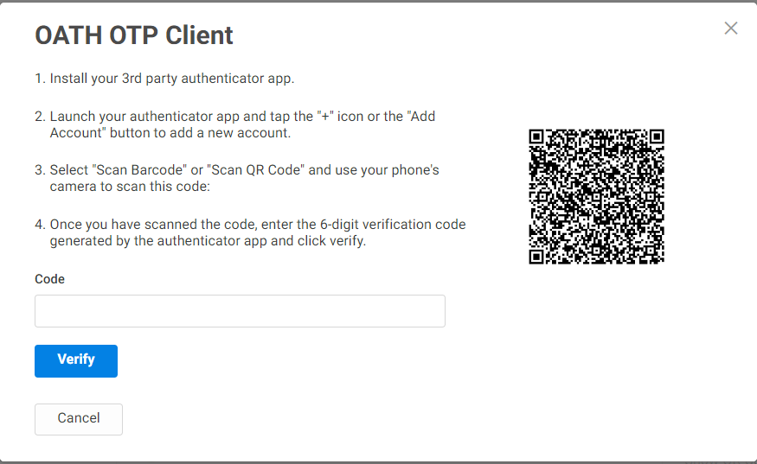
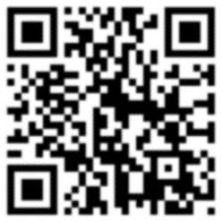
How Do I Set Up MFA?
Step 3: This will bring up the OATH OTP Client QR Code. Keep this page open.
Training Together

Slide 11
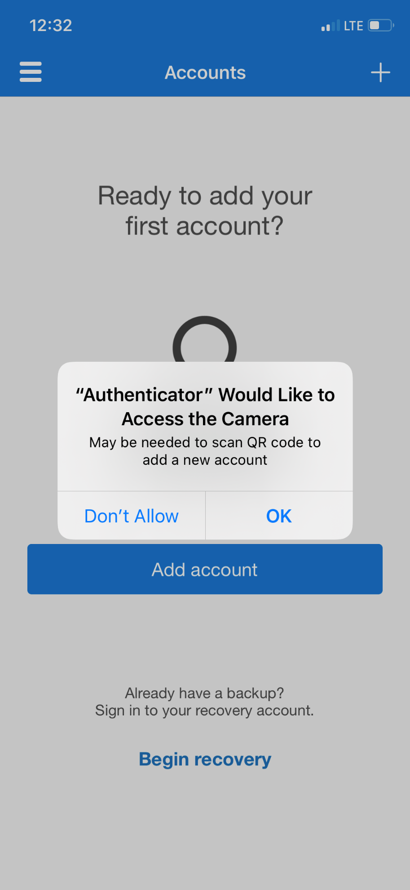
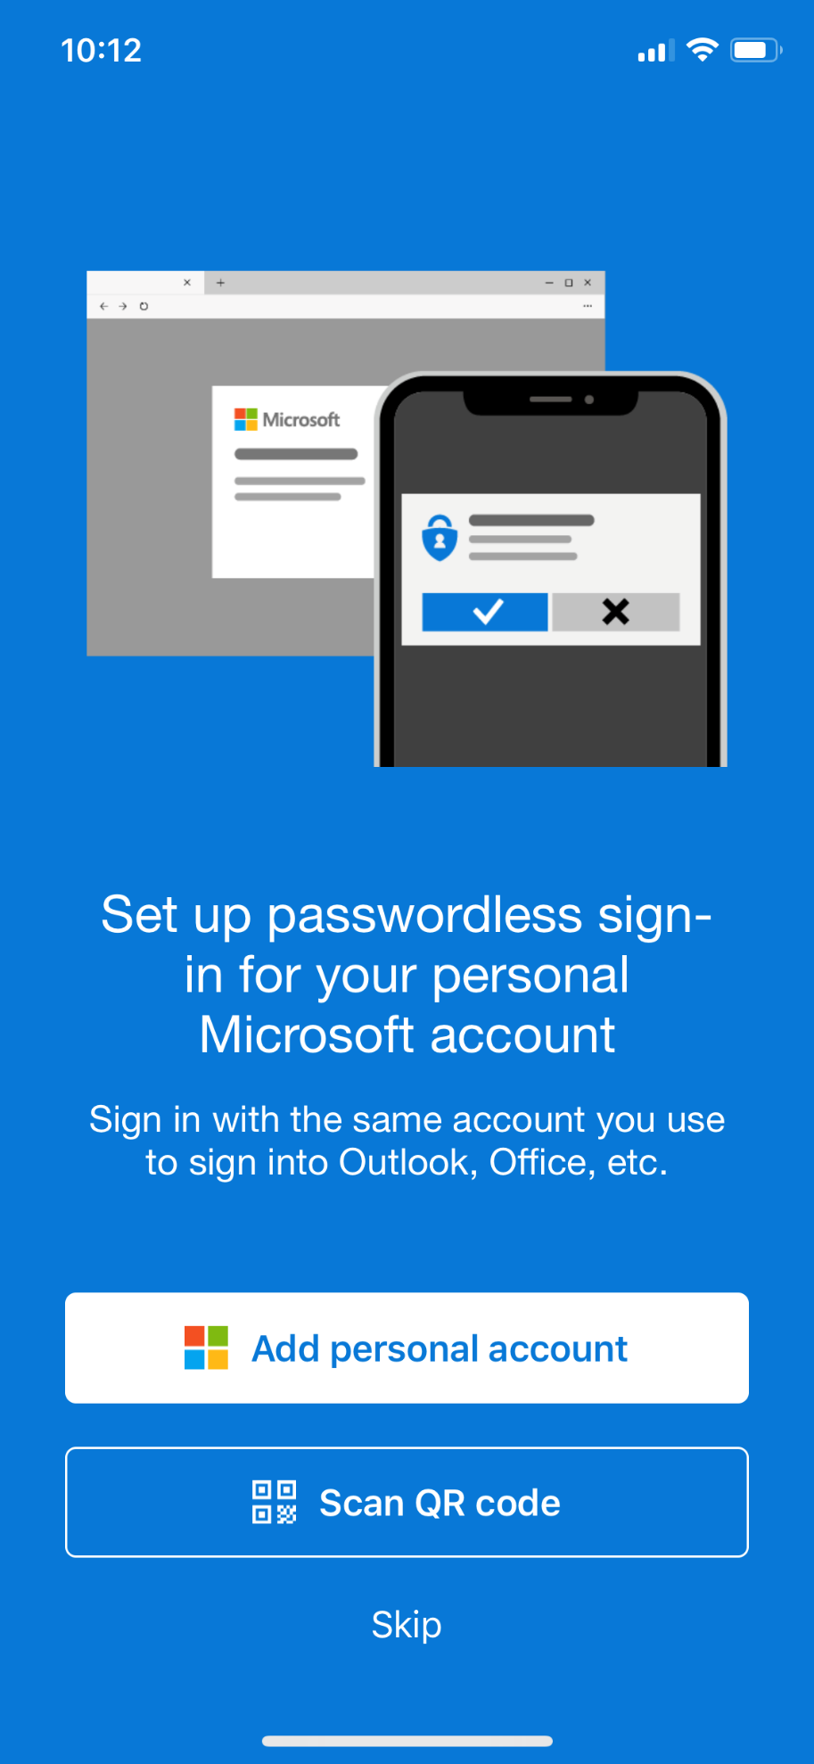
How Do I Set Up MFA?
Step 3 Continued: Open the Microsoft Authenticator app on your phone and select “Scan QR code”.
Click “Scan QR Code.”
Open the Microsoft Authenticator app. Click “OK” to allow access to the camera if prompted.
Training Together

Slide 12
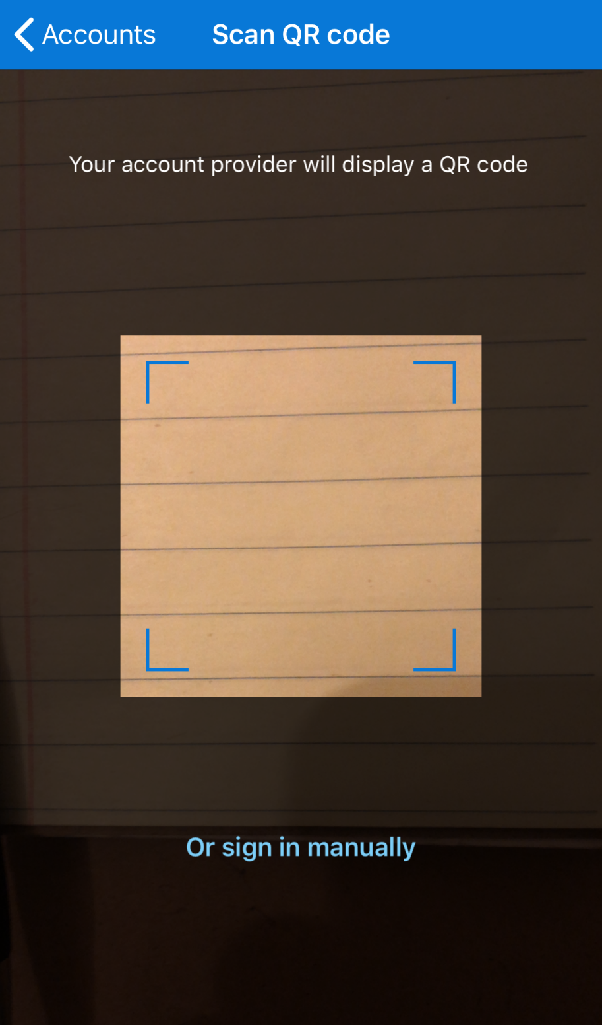
How Do I Set Up MFA?
Step 3 Continued: Scan the OATH OTP Client QR code with your Microsoft Authenticator app.
Training Together

Slide 13
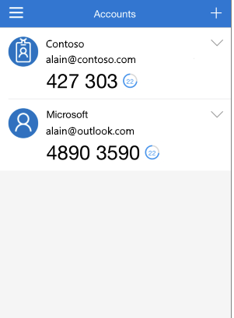
How Do I Set Up MFA?
Step 4: Enter the 6 digit verification code that is generated in the Microsoft Authenticator app.
Enter 6 digit Code Here
Important note: The verification code in the Authenticator app changes every 30 seconds.
It’s okay if it times out! Enter the new code that appears.
Training Together

Slide 14
How Do I Set Up MFA?
Step 4: Select “Verify” once the code is entered.
This completes your MFA setup process. You are now ready to use your VPN!
427303
Training Together

Slide 15
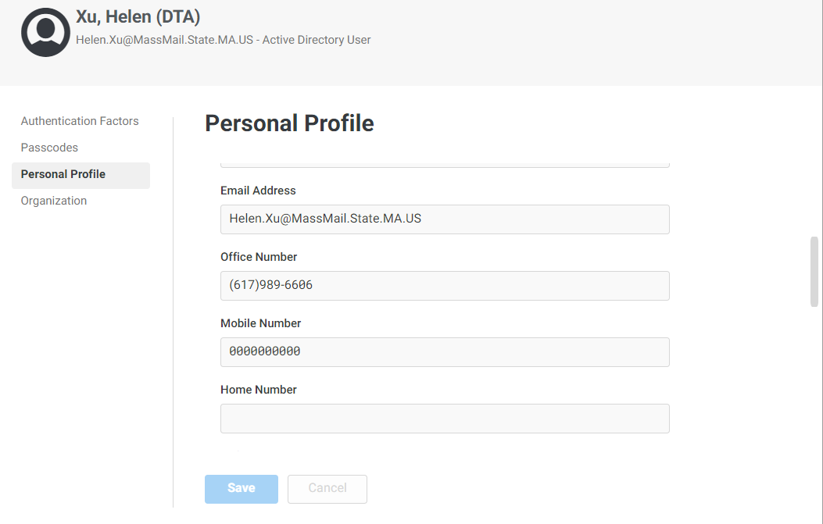
How to Remove a Phone Number in Centrify:
Quick Tip: If you previously entered your personal cell phone number in Centrify, you can remove it by accessing your Personal Profile.
Delete the Mobile Number entered here and hit “Save” to remove your phone number.
Important note: It will take 1 day for this change to be updated in the Global Address Book.
Training Together

