Slide 1
Commonwealth of Massachusetts Department of Developmental Services (DDS)

Slide 2
DDS Initiatives for Adults With Autism but Without Intellectual Disability
Presented by:
Regional Autism Program Coordinators
Lea Hill, Northeast Region
Maria Stefano, Metro Region
Pamela Ferguson, Central/West Region
Shannon Hubley, Southeast Region

Slide 3
DDS Only Served Individuals with Intellectual Disability until the Autism Omnibus Law of 2014 was passed.
DDS expanded eligibility to include Adults with Autism, Prader-Willi without Intellectual Disability and Smith-Magenis Syndromes.

Slide 4
2014 Autism Omnibus Bill Highlights
Established the MA Autism Commission as a permanent body within EOHHS
Sub-Committees on Employment, Housing, Adult Services, and more
Changed eligibility criteria for DDS
Required DDS and DMH to collaborate and coordinate sharing resources for eligible adults with ASD and mental health issues

Slide 5
DDS Structure
DDS serves under the umbrella of the Executive Office of Health & Human Services (EOHHS).
There are 4 DDS Regions across the State.
Metro Region
Northeast Region
Southeast Region
Central/West Region
Central Office in Boston oversees the Regions.

Slide 6
DDS Structure
Each Region consists of:
Area Offices
Area Director and Assistant Area Director
Clinical staff
Supervisors
Autism Service Coordinators
and others

Slide 7
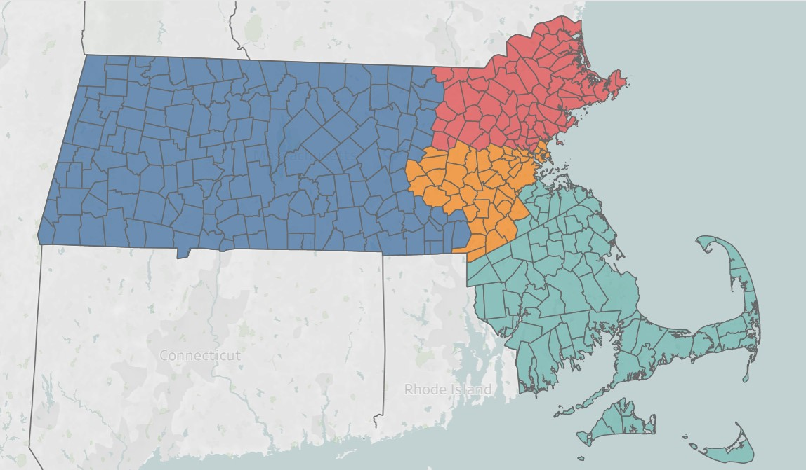
DDS Regions

Slide 8
Eligibility Information
DDS eligibility is determined by the Regional Eligibility Teams.
Once found eligible, the individual is assigned to an area office based on town of their permanent residence.
The Area Office assigns the individual to an Autism Service Coordinator who will contact the individual to set up an initial meeting with the individual and family.

Slide 9
DDS Adult Autism Eligibility
Diagnosis of autism by a qualified clinician is required.
Eligible individuals must have substantial functional impairments in three or more of the Seven Areas of Major Life Activities.

Slide 10
DDS Adult Autism Eligibility
The Seven Areas of Major Life Activities:
Self-Care (ADL)
Expressive Communication
Receptive Communication
Learning
Mobility
Capacity for Self-Direction
Economic Self-Sufficiency

Slide 11
DDS Adult Autism Eligibility
Adult autism eligibility applications may be submitted at age 17, even if the individual is still enrolled in school.
DDS adult funded services begin once the individual is out of school (18-21) or reaches age 22.
All DDS services and supports are subject to legislative appropriation during the Commonwealth’s yearly budget process.

Slide 12
DDS Adult Autism Eligibility
If an individual was DDS eligible as a child, he/she must apply for Adult Eligibility in order to access adult services.
Adult eligibility remains throughout the lifetime unless the individual relocates out of state.
DDS services are voluntary.

Slide 13
DDS Adult Autism Eligibility
Download the Application:
https://www.mass.gov/lists/dds-eligibility-forms
Available in English, Spanish, Portuguese, Vietnamese and Chinese. Other languages available upon request.
Eligibility Fact Sheet for Adult Autism Spectrum Disorders:
https://www.mass.gov/lists/your-guide-to-the-dds-eligibility-process

Slide 14
DDS Adult Services
Autism Service Coordinator
This is an important relationship! The Service Coordinator facilitates the development of services & supports with provider agencies and other resources in response to the individuals needs and desires
Ask your Autism Service Coordinator about self-directed service options.

Slide 15
Frequent Service Requests for Adults with Autism
Individual Supports
Examples:
Adult Companion
Independent Living Skills Development
Skill Training & Job Development
Referral to Clinical Supports
Behavioral, Psychiatric, Assistive Technology
Day/Employment Supports
Individual and Group Supported Employment

Slide 16
Frequent Service Requests for Adults with Autism
Autism Coaching
An individualized one on one service with a qualified professional coach.
In-person or remote
College Navigation
Assists college students with developing executive functioning skills, social skills, and navigating the campus life experience.
On-campus for MA colleges or remote

Slide 17
NEW Regional Adult Autism Support Centers
Information & Referral Services
Family Trainings
Parent Networking
Community Connections & Resources
Service Navigation
Social & Recreation Events
All centers can assist with the DDS application process
DDS Statewide Family Support Directory
https://www.mass.gov/dds-family-support

Slide 18
Collaboration with DMH
Area Office Case Review
During eligibility process & ongoing
Psychiatric consultation
Psychiatric fellowships
Clubhouses (DMH eligibility not required)
Collaborative training and staff development opportunities

Slide 19
DDS Autism Program Coordinators:
Northeast Region – Lea Hill
Lea.Hill@Mass.gov
Metro Region – Maria Stefano
Maria.Stefano@Mass.gov
Southeast Region – Shannon Hubley
Shannon.Hubley@Mass.gov
Central/West Region – Pamela Ferguson
Pamela.P.Ferguson@Mass.gov

