Slide 1
Risk Management and Internal ControlS: Preventing and Reporting Theft, Fraud, and Financial Abuse in DDS area and regional offices
Massachusetts Department of Developmental Services

Slide 2
Agenda
Define Risk and Internal Controls
Discuss the importance of Internal Controls in the prevention of theft, fraud, and financial abuse
Examine the purpose and components of the Internal Control Plan
Review how to recognize and report theft, fraud, and financial abuse

Slide 3
DDS Mission
The Department is dedicated to creating, in partnership with others, innovative and genuine opportunities for individuals with intellectual disabilities to participate fully and meaningfully in, and contribute to, their communities as valued members.
What could prevent DDS from achieving its mission?

Slide 4
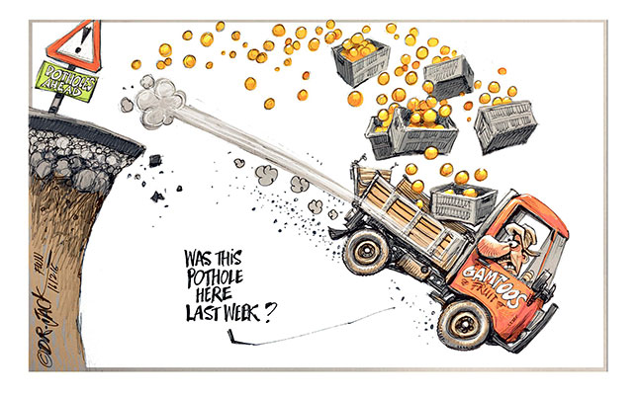
Unanticipated Risks can derail the best missions, goals and plans

Slide 5
Risk Happens
Risk: potential of losing something of value.
Business Risk: foreseen or unforeseen events, actions or inactions which may adversely affect the department’s achievement of objectives, goals and mission.
DDS has business practices and methods of delivering services which include an element of risk that resources and services may be misused, or stolen.
Risk is a fact of life. What can we do about it?

Slide 6
risk assessment activity
There can be a number of business risks in something as basic as buying fresh fruit. I bought too much, I didn’t need it - I already have plenty of fruit, and it goes bad before I can eat it all (waste)
I bought the wrong kind of fruit, nobody in my house likes those kiwi’s(misuse)
It was overpriced– I can get it cheaper elsewhere (carelessness)
I was overcharged – the cashier rang up the wrong price (carelessness or theft)
I was shorted – its not all there, the grocery delivery service may have stolen a banana after I paid for it (theft)

Slide 7
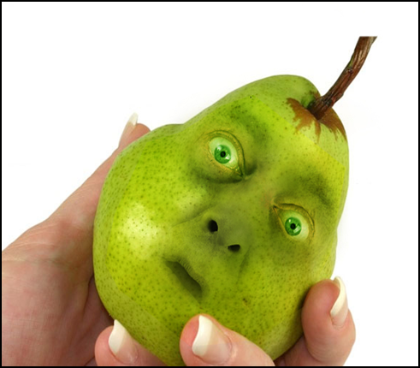
Managing risk
There are things that I can do to manage my fruit buying risk. These are internal control procedures.
Use a shopping list so I will purchase the correct amount and type of fruit
Be an informed shopper who is familiar with the food and fruit prices at my local stores
Check the store receipt to make sure that I was charged the correct price
Check my groceries when they get delivered to insure that they are all there

Slide 8
DDs risks
In the course of daily operations, DDS has thousands of procedures and transactions which expose it’s resources to risk. Here are just a few examples:
DDS Staff enter and approve time in the SSTA system
DDS Area Offices contract with private agencies to provide services for our individuals.
Participant Directed Services allow individuals and families to purchase allowable goods and services with DDS funds

Slide 9
Internal Controls
Theft, Fraud and Financial Abuse Prevention

Slide 10
Internal Controls
Internal Controls are the policies, procedures, techniques, and mechanisms that mitigate risk.
Internal Controls are common sense practices which help us to manage risk while not being overly burdensome.
Think of control activities in your personal life…
Lock your car or house doors
Match credit card receipts to monthly statement
Wear a seatbelt
See your doctor for regular check-ups
Notes:
We all have internal controls in our own life.
For example

Slide 11
DDS Internal Controls
Internal controls involve:
A standard procedure – everyone does it the same way
Clearly assigned roles –Segregation of duties – separate parts of a task are performed by different people. This provides accountability. If one person purchased the office supplies, a different one checks to see that they were all delivered to the office.
Good documentation– a clear written account of what was done, when, and by whom. This enables DDS to go back on check on things that the control procedure is intended to keep track of.

Slide 12
Components of Internal Controls
All staff are trained in and comply with internal control procedures. Compliance is monitored, and non compliance is reported.
Periodic comparisons are made between the actual resources and the recorded transaction to insure accuracy. Any unaccounted for variances are reviewed, reported and investigated.
Internal control procedures provide a clear process for reporting theft, fraud and financial abuse.

Slide 13
DDS Internal Control Example
Inventory:
When purchasing furniture, a state agency places an tag on each piece, with a unique inventory control number.
A list is kept of all the furniture, the locations, and the inventory control numbers.
Annual inventory checks are conducted to insure that all the furniture is accounted for.

Slide 14
Internal Control Plan
Managing Risk

Slide 15
Internal Control Plan
The Internal Control Plan (ICP)
Begins with the Departments Mission and strategic objectives
Assesses the risks which could prevent us from meeting our objectives (including waste, misuse and theft of state resources)
Describes how DDS will manage each of those risks
References the control procedures which will eliminate or minimize the risks
Includes a methodology to evaluate whether the control procedures are being followed, and if they are effective
Is communicated throughout the department
Is continuously monitored and updated
Notes:
COSO is…

Slide 16
Internal Control Plan Revision
The plan, by law, is required to be reviewed annually, or more often as conditions warrant:
Changes in laws and regulations
Changes in organizational structure
Changes in agency priorities
Changes in funding
Audit findings
Statewide Risk Management Team recommendations
Changes to detailed policies and procedures
Existing procedures prove ineffective

Slide 17
DDS Requirements
Chapter 647 of the Acts of 1989 requires that DDS:
Maintain a system of internal controls, which are clearly documented and readily available for examination. These controls include a way to track and document transactions which involve the commonwealth’s resources.
Incorporate these internals controls into standard operating procedures and insure staff are trained in and comply with the internal control procedures. Compliance is monitored.
Identify instances of theft or loss, or failure to comply with the internal control procedures and report them promptly to the appropriate parties.

Slide 18
Risk management and Internal Control
Summary Activity

Slide 19
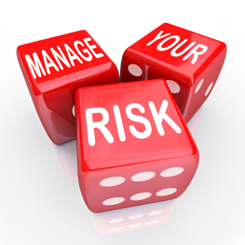
Risks and controls
In the next few slides we will look at some examples of risks in area and regional offices and how internal control procedures can be used to manage them. These are examples which are intended to illustrate how internal control procedures could manage risk. They are not the actual internal controls procedures. Those procedures are available for your review at your worksite.

Slide 20
Purchasing Day Hab. supplements
How do we know that we are getting what we pay for?
Better Days is an agency that provides Day Habilitation Services for 45 individuals.
Better Days receives Day Hab. supplements for 4 individuals.
The supplements are for 1:1 staffing for each individual.
There is a significant turnover of staff at Better Days.
The assignment of 1:1 staff is not always clear. Some staff who are supposed to be providing 1:1 support seem to be working with a group on individuals.

Slide 21
Day Hab. supplement controls
What procedures could hold the provider accountable for providing the correct amount of staffing?
The area office asks the provider to submit a staffing schedule for the day hab. program, which includes designation of staff assignments for the 1:1 staffing support.
The area office also asks the provider for a payroll report which will enable them to verify that the staff on the schedule, did indeed work the shift as assigned.
Service coordinators visit the program regularly, and use the schedule which was provided by Better Days to insure that the correct number of staff are present and that 1:1 staffing is being provided to those individuals who have the day hab. supplemental funding for it.
The area office works with the provider to use the extra staffing for developing and working on goals, tracking progress.
This is reviewed to verify that the extra staffing is being used as planned

Slide 22
monitoring Family Supports
How can we be sure that DDS dollars are used to purchase allowable goods and services in family support services?
Family Matters is an agency that provides family support services.
They have a contract to distribute funds to families who have members with I.D. living at home. The funds may only be used in accordance with program guidelines.
The Adams family asks for some modifications to their bathroom in order to make it more accessible for mobility needs.
The request is approved and Family Matters selects a contractor to do the work.
All of the approved funding is supposed to be used on bathroom accessibility modifications as approved by the Area Office.
The invoice from Family Matters is not paid until the work is completed and verified.

Slide 23
Controls on major purchases
What procedures could provide verification that the work was performed as authorized, in the most cost effective way?
Any Purchases in excess of $3,000 requires prior approval by the Area Director and the Regional Director.
Three separate bids from vendors must be acquired.
Payment for the work is made on a schedule, which corresponds to stages of completion.
The Area Office will visually inspect the stated work once it has been completed, before the final payment is made.

Slide 24
Travel reimbursements
How do we know if staff are submitting valid travel reimbursement forms?
Staff submit monthly travel reimbursement forms for mileage that they drive in their own vehicles for work.
Supervisors are charged with reviewing these forms for accuracy before approving them and passing them on to the business office for payment.

Slide 25
Controls for travel reimbursements
What procedures could support more accountability in employee travel reimbursements
The are office requires that staff document all of their external appointments in a book which is kept in the office
When staff submit travel reimbursement, all travel should be reflected in the appointment book
When a supervisor is reviewing/approving a travel reimbursement, they check the appointment book to insure that it is consistent with the reimbursement submission.
Any discrepancies are reviewed and resolved with the staff prior to approving the reimbursement. Appointment can be verified with other parties, and mileage amounts can be checked as needed.

Slide 26
Risk Assessment
We have looked at three job duties which involve include transactions with DDS or with our service recipients resources. We identified an element of risk in each transaction and detailed control procedures which could eliminate or limit those risks. Can you think of other job duties which involve risk? What control procedures might be effective in managing risk?

Slide 27
Some DDS Business Risks
Missing inventory
and supplies
Misuse of Participant Directed Funds
Provider agencies not meeting the terms of their contract
Fraud involving
Family Support funds
Theft of state resources
inaccurate
Travel reimbursement
Payroll errors
Waste

Slide 28
Recognizing and Reporting theft, Fraud and Financial abuse
Department of Developmental Services

Slide 29
Protecting DDS Resources
Stealing or misappropriating money, property or services from the Commonwealth or from a service recipient is a crime.
DDS serves more than 38,000 people, with 6,000 employees and a budget of around $2,000,000,000.
DDS conducts hundreds of transactions each day which expose its resources to risk, including :
Purchasing goods and services
Allocating and paying staff
Contracting with providers, etc.
DDS has internal control procedures in place to manage these risks.
Deviating from internal control procedures exposes DDS resources to risk

Slide 30
Tone at the Top
Fraud Prevention and Internal Controls are a top priority for DDS
Our Commissioner and our Managers attitudes, actions, and values set the tone for our agency.
Management Responsibilities
DDS management has to convey the importance of internal controls by:
Communicating how department’s mission, goals and objectives are supported by strong internal controls
Conveying that employees at all levels are critical to a strong system of internal controls
Demonstrating that DDS has a zero tolerance for unlawful, unethical, or questionable behavior
Insuring that DDS Workplace culture encourages:
Questions
Opinions
Expressions of concern
Notes:
Tone at the Middle

Slide 31
What can you do to help?
Effective internal controls require everyone’s contribution
Make sure that you know what is expected of you with the control procedures. If you are not sure, then ask.
If you have an idea as to how to improve the control procedures, we would love to hear it.
You may know of a job duty of transaction with carries risk, for which we may need a control procedure. Perhaps management does not realize that the risk is present. If this is the case, please speak up.

Slide 32
Why Report?
It is required by law: Chapter 647 of the Acts of 1989
All unaccounted for variances, losses, shortages or thefts of funds or property shall be immediately reported to the state auditor's office, who shall review the matter to determine the amount involved which shall be reported to appropriate management and law enforcement officials.
“The State has plenty of money – they won’t miss it, will they?”
The service recipients will receive less than they need, less than they deserve, less than they are entitled to.
We have a moral imperative to insure that the resources intended to help people with disabilities are used for that purpose.
We have a responsibility to the safeguard the public trust to insure that our tax dollars are spent for the purposes intended.
It is everyone’s duty to comply with the internal control procedures and to report instances of theft and fraud.
Reporting theft and fraud enables the department to accurately assess the effectiveness of its internal controls to prevent future occurrences.

Slide 33
slippery slope
The work we are doing for people with disabilities is important
If our co-workers take shortcuts with control procedures or if they steal from DDS and are not held accountable, than what type of effort do you think they will give when it comes to client care?

Slide 34
When to Report
You have reasonable cause to believe:
State resources or those of service recipients are being stolen or misused.
A staff member(s) is deviating from the internal control procedures which were designed to protect the resources of the commonwealth and its service recipients.

Slide 35
What to look for
Theft, fraud and misuse of state resources can take many forms. Some indications could be:
You saw somebody take something that belongs to the state or to a service recipient
Lack of record keeping or gaps in the records
Discrepancies in records
Missing items
Bills are higher than expected (such as a much larger long distance phone bill in one area office)
Staff who are on shift are not where they are supposed to be
Staff refuse to follow internal control procedures

Slide 36
How to Report
All instances of unaccounted for losses, theft, fraud, waste, misuse and misappropriation of resources shall be immediately reported to the
DDS Theft and Fraud Hotline
If you are not comfortable in identifying yourself in reporting, you can report anonymously to the hotline voice messaging line: 1-844-292-6088.
Those calling from a DDS office phone can use the VOIP number: 624-7801.

Slide 37
Whistleblower Protections
Chapter 149, Section 185 of the General Laws protects public employees who wish to make disclosures to expose violations of law or risk to public health, safety or environment in a “whistleblower” mode.
Who is Protected?
Employees of the Commonwealth
What are whistleblowers protected from?
Firing
Suspension
Demotion
Any adverse employment action being taken as a reprisal
What kinds of disclosures are protected?
Disclosure of any activity or practice that is in violation of a law, rule or regulation, or poses a risk to public health, safety or the environment

Slide 38
Follow Up
When an incident is reported to the Theft/Fraud Hotline, DDS will:
Utilize the DPPC hotline to insure that the state police reviews the case
Investigate the allegation.
Produce an action plan or administrative review upon completion of the investigation.
Notify the state auditor’s office and refer the case to law enforcement if these are appropriate responses to the investigation.
Determine whether to pursue individual accountability through employment consequences.
Evaluate the effectiveness of the relevant internal control procedures and make improvements and recommendations as needed.

Slide 39
Handling it “in house”
If a staff person is caught stealing, but they pay the money back, does the theft need to be reported?
YES – You still need to report
DDS will investigate of the incident to determine the extent of the theft. There may have been additional fraud events which should be investigated.
The incident may need to reported to the state auditors office and/or to law enforcement. This needs to be determined at the Central Office level.
The decision regarding potential employment consequences for the staff member needs to include input from DDS Central Office
DDS is continually assessing and revising its internal control procedures. It is important to know if procedures are ineffective in order to correct the problem.

Slide 40
Self Directed Services financial abuse of individual and theft of state resources
Any theft, misuse or misappropriation of funds or services intended for individuals through the Participant Directed Program or through Agency with Choice must be reported as both, as per the Real Lives Law:
When you call theft and fraud hotline, the allegation will be called into the DPPC. It will be investigated as potential financial abuse of a person with a disability, and may subsequently be reviewed in terms of theft of state resources.

Slide 41
In Conclusion
When someone steals from the DDS, they are stealing from people with disabilities, from taxpayers, from all of us.
DDS resources are exposed to risk every day.
Internal control procedures helps to manage those risks
The procedures serve to standardize the way in which things are done. They include the way to do things, designated roles, a method of documenting, tracking and verifying what was done.
Someone who was not involved with the transaction regularly reviews and verifies the documentation to insure that there are no discrepancies.
Preventing theft, fraud, and misuse of state resources by following internal controls is everyone's responsibility.

Slide 42
Thank You!

