Slide 1
DDS Children’s Autism waiver program
2020 Renewal
Autism Support Broker Training
July 20, 2021
9:00 – 12:00

Slide 2

Welcome and Introductions
Recap from Previous Meetings
Autism Support Plan Review and Changes
Review New Rates Implementation
ASB Monthly Meeting Form and Safety Awareness
Emergency Fact Sheet Review and Changes
Broker Supervisor Role and Responsibilities
Questions
Reminder of Recording

Slide 3
Recap from Previous Meetings
June 17th^{th} Meeting
HCSIS Training
June 28th Meeting
WELCOME/ OVERVIEW OF CHANGES
CAP CHANGES
CHANGES TO WAIVER SERVICES
RATE CHANGES
MANDATED REPORTER/ RETURNING TO LIFE BEYOND THE SCREEN
QUESTIONS
RECORDING REMINDER

Slide 4

Autism Support Plan
Review and Changes

Slide 5

Autism Support Plan
The Autism Support Plan (ASP) is a required document for the AWP.
It must be completed annually.
This planning document is a very helpful tool that assists the team in getting to know the child and the family.
This is a rapport building activity. This is a time to engage with the family to build your relationship.
There are several updates to the document.
Every section must be filled out in complete sentences.
New form goes into effect 9/1/21.
Everyone’s plan must be updated into new form by 12/31/21

Slide 6
Demographics
Child’s Name: | Date of Birth:
Parent/Guardian Name(s):
Address:
School Program: | Date of Autism Support Plan:
Lead Autism Support Center: | Primary Language of Family: Is an interpreter required? Yes No
Ryan Summer 11/22/2017
Sally Winter and Dan Summer
1234 Centre St Lynn, MA 01905
Johnson Elementary School- Lynn Public Schools 2/07/202
Northeast Arc Spanish X

Slide 7


Individual Profile
1. Who are the members of the planning team and people involved in the implementation of the program? (include responsible adults home during sessions, etc.). Please check for responsible adult(s)/release on file.
Name | Relationship
Sally Winter and Dan Summer Parents
Jane Smith Grandmother
Frank Kelly Autism Support Broker
Olivia McGlone Autism Clinical Manager
Jeff Jones Senior Level Therapist
Who is a responsible adult? Someone over the age of 18 that can fill in for the guardian when they are not available. For example, present during session, sign off on timesheet, etc.
When meeting with the family to complete the ASP, have several blank release forms with you and get them signed at the meeting.

Slide 8
2. Who lives in the home and have there been any changes in the last year? Yes No
(information is included in the CCA) Please check for responsible adult(s)/release on file.
Name | Relationship
Notes:
Sally Winter Mother
Jane Smith Grandmother
Bill and Sally Sibling
Ryan lives with his mother, grandmother and two younger siblings. His father, Dan recently moved out the home and lives close by. He is frequently at the home and is present for sessions.
Examples could be the birth of the sibling, a parent leaving the home, a sibling going away to college, the family has moved in the past year, or is currently homeless and/or in a shelter. If there have been no changes, please note so.

Slide 9
3. Are there other people who provide support to the child who live outside of the family home? (information included in the CCA)
Name | Relationship
Joan Sanders family friend
These are people that help with the care of child. Examples could be grandparents, respite worker, PCA provider, close family friend. If there is no one, note n/a.

Slide 10
4. What are the current supports and services the child receives? (ex. MH ABA, 766 Program, DCF, DPH, Personal Care Assistance, food stamps, fuel assistance, SLT, OT, PT, etc.). Please check for release on file.
Type of Support | Total Number of Hours Per Week | Name/Contact Information
IEP 30 hours week Mrs. Simmons/Teacher (781)238-1297
In-home ABA Services through MassHealth 10 hours week direct New England ABA (718) 237-1297
OT 1 hour week Spaulding
DCF as needed case worker: Kelly Smith (617) 237-1271
SSI $652 month n/a
We want to get a good picture of the supports in place for the child. Examples include IEP, Early Intervention, PCA, or social security. Along with the service the child is receiving, please include the amount of the service (hrs/wk or monetary amount per year). If there are no other services the child is receiving, it must be noted.
Make sure have several blank release forms with you and get them signed at the meeting.

Slide 11
5. Describe the child’s strengths (these are things the child enjoys or does well that may help in developing strategies to address objectives).
Ryan enjoys playing games on the computer and painting. He likes paws patrol but requires adult interaction to stay engaged. He likes the iPad at school. Ryan is very active and likes the playground. He enjoys cooking with his grandmother. Ryan has very strong imitation skills and memorizes things very quickly.
This question is important for providers who are developing programs and assists the team in getting to know the child.
This should be answered with a short paragraph.
Examples could include the child physically active and loves to play outside. He enjoys playing with electronics and can do so independently. He has a great memory and remembers things very easily.

Slide 12
6. Describe the child’s challenging issues (these are things the child does that make day-to-day living difficult for you and your other family members.
Ryan has a short attention span. Expressive and receptive communication is difficult for him. He can be aggressive and exhibit tantrums. He has a very high pain tolerance. Ryan is picky eater and eats a limited number of foods. Social skills are a challenge. He doesn’t like being in the community if he is not in stroller or in the cart. Ryan will bolt from the home and in the community.
The ASB should try to get a good picture of what the daily life is for the family and what challenging could arise.
This could include difficulty understanding what the child wants, tantrums when a toy is taken away, bolting from the home and limited ADL skills.

Slide 13
7. Team conducted an assessment and reviewed the following needs/concerns. If any answers are yes, please describe below and note steps taken to access other funding sources.
Are there current safety concerns? (ex. child trying to leave the home or tries to climb out windows) Yes No
Need for home or vehicle modification? (ex. getting out of seatbelt or opening windows or doors) Yes No
Need for assistive technology? (review outside evaluations from school or insurance providers. Ex. sensory item identified by SLT/OT) Yes No
Need for individual goods and services? (must increase functioning, increase safety, and decrease dependence on Medicaid services. ex. adaptive swim lessons) Yes No
Ryan will try to leave the home when doors are left open. He has also tried to climb out his bedroom window. Ryan’s mother has requested window bars from housing and waiting to hear back. We discussed getting door chimes through the waiver.
Ryan has a sensory diet in place at school that uses a weighted vest, a therapy ball and chew tubes. The SLT will reach out to the OT to see how these can be used at home.
Ryan recently had an AAC evaluation. They recommended a touch chat and submitted to MassHealth for the device.
Ryan’s neighbor had a swimming pool. He has bolted for the pool on occasion. The team talked about starting adaptive swim lesson for this safety concern.

Slide 14
8. What are the goals that you would like your child to achieve from the supports available in this Autism Waiver Program?
Increase functional communication
Decrease challenging behaviors
Increase activities of daily living
Increase social skills
Increase safety awareness
1.
2.
3.
4.
5.
This section includes the goals the providers will be working on during sessions. They should correlate with the challenging issues in section 6.
These are general goals and objectives are broken down on the grid. For example, the family may say the child has limited communication and they don’t always know what he is asking for. A goal could be to increase functional communication including requesting.

Slide 15
9. What are the child’s learning styles the support person must understand in implementing supports? (ex. quiet environment, low distractions, small groups, visuals, etc.)
Visual supports are extremely helpful. Ryan also does well working in environments with low distractions and 1:1 staffing.
This is helpful to staff coming into the home. It will help with the development of programs. Examples for this section could include that the child learns well with visual supports including using PECS. The child works well in a 1:1 setting and with staff with low affect. This information can also be found on the IEP if available.
Can prompt the family by asking the question “tell you a time the child was successful at learning something new?”

Slide 16
10. Are there family concerns that affect the support to the child? (ex. risk of losing home, medical needs of the primary caregiver, etc.)
The family has moved several times of the last two years. They are concerned they may need to move again due to concerns with the landlord. The grandmother that lives in the home has several medical conditions that require frequent doctor visits.
The family may offer some answers that are good for everyone to be aware of. For example, if a caregiver has chronic medical need it could affect the support to the child, mom is taking care of an aging parent, issues with the landlord or if the family is homeless/is going to lose the home.
If there are no concerns, it should be noted.

Slide 17
11. What is your plan in case of emergency? Do you have other people that could assist with care of the child? (ex. medical emergencies)
There are several adults that could care for the children in case of emergency. This includes mom, dad, grandmother, and a family friend. Dad’s parents live in New York and could come assist if there was an emergency.
This is to prompt families to think about what they would do if there as an emergency. Do they have families or friends they could contact for help?
If the answer is no that is okay. This is important information for us to know. Down the road, we can maybe help the family connect with others through community activities or support groups.

Slide 18
12. What are the supports necessary for the family to self-direct waiver services? (ex. supports to be able to hire, fire, supervise, complete time sheets, etc.)
The family will need the assistance of the broker to coordinate all waiver supports.
This section reviews how much help the family will need from the ASB and the ACM. For example, a parent may need help with all paperwork and finding staff.

Slide 19
13. What services do you think will help reach those goals that you would like to see addressed through the waiver program? What are the objectives (incremental steps) to help reach that goal? (objectives must be written in measurable terms in order to track progress toward meeting criteria).
Goals: | Objective: | Provider Type: (Ind/Agency/Vendor) | Waiver Service: For Expanded Hab, Education list type (Ex: ABA, Floor Time, RDI, etc.), Family Training, etc. | Frequency/ Duration
Increase functional communication
Decrease challenging behaviors
Increase activities of daily living
Increase social skills
Increase safety awareness
-Increase receptive language
-Increase expressive language
SLT: 4 hours month DSW: 6 hours week
Agency
ABA
-Decrease instances of aggression
-Decrease instance of bolting
-Decrease instance of tantrums
Agency
ABA
SLT: 4 hours month DSW: 6 hours week
-Increase the variety of food
-Increase independence with tooth brushing
Agency
SLT: 4 hours month DSW: 6 hours week
ABA
Agency
ABA
SLT: 4 hours month DSW: 6 hours week
-Increase ability to take turns
-Increase ability to answer personal ID questions
-Increase independence following directions stop/come her
-Increase safety awareness in the home and community
SLT: 4 hours month DSW: 6 hours week
$45
$400
$350
Agency
Vendor
ABA
Home modification: door alarms
Assistive Tech: lojack
Goods/services: adaptive swim lessons
___________________________________________________ ­__________________
Signature Date

Slide 20
14. Are there any specific training (to be provided by the Caregiver) that staff will need to work with the child (ex: child has severe allergy and has EpiPen that must be delivered in emergency situations)
1.
2.
3.
Ryan is allergic to peanuts. Providers should not consumer peanuts or peanut butter the day of services. Parent would provide EpiPen in an emergency.
If the child has medical needs such as food allergies or seizures, this should be documented here and on the emergency fact sheet. The trainings will be provided by the parent/caregiver.

Slide 21
15. Describe any additional trainings staff must complete prior to working with child (record information on training document).
1. Mandated Reporter Training
2. Incident Reporting Training
3. Emergency Plan Training- What to do if there is an emergency in the home
4. HIPPA
Providers are required to review mandated trainings including mandated reporting, HIPPA, and fire safety. The training should be listed in this section.
The training document must be signed by all independent providers on a yearly basis and attached to the ASP.
If the services are being provided by an agency, the agency is required to provide these training and the AWP training form is not required. Note in Section 11 the agency provides this training.

Slide 22
16. Important Emergency and other information for employees working in the home:
Form is attached to the plan: Yes No
This should always be yes. The emergency fact sheet must be attached to the ASP.
17. Supporting Documents: (the following documents were reviewed and are on file)
Document | Reviewed Y/N | On File Y/N
Individual Education Plan (IEP)
Individual Flexible Family Support Plan (IFSP)
Any current behavior plans
CCA
Vineland Summary
Physical | Date:
Dental | Date:
Other documents (e.g., in home ABA treatment plans, SLP, OT, PT assessments, other school-based assessments):
n/a
n/a
3/2021
2/2021
Reaching out to other providers to get copies of OT assessments and in-home ABA progress report

Slide 23


Autism Support Broker please initial:
I have given the parent/guardian access to the Provider Website (https://fms.publicpartnerships.com/maasd) and/or provided with a list of approved providers relevant to the services in this plan.
Parent/Guardian please initial:
I have been given access to the Provider Website (https://fms.publicpartnerships.com/maasd) and/or provided with a list of approved providers relevant to the services in this plan.
I understand that I have access to an interpreter if English is not my native language.
I have been informed how to report abuse, neglect, exploitation, and unexplained deaths.
I give permission for my child’s picture to be used on the emergency fact sheet.
FK
Even if family is happy with current provider, the ASB must provide access to approved providers annually and box must be checked.
SW
SW
SW
SW
Families now must be provided with training documents to ensure they know how to report abuse, neglect, exploitation and unexplained deaths. Provide copies when having parents initial these boxes.

Slide 24
The following people have reviewed the plan:
Family Member/Guardian: ___________________________________ DATE_______________
Support Broker: ___________________________________ DATE_______________
Autism Division Designee: ___________________________________ DATE_______________
The ASP must then be signed by the family/guardian, ASB and ACM. The signature date should be the date of the ASP.

Slide 25


Slide 26

Provider Rate Changes

Slide 27
Rate Changes Reminders
Details of the rate changes were covered in our June 28th meeting.
The increase is not blanket increase or automatic.
ASB should be speaking with families first.
Some providers may have to wait until a new budget year before getting the increase.
The changes are to the rate CAPS. Rates should be negotiated by the family and provider.
DDS will notify all providers of change in Fall of 2021.
RBT services are not available until Fall 2021!!!

Slide 28
Rate Changes
All rate caps have increased except for the Respite in the Home of a Caregiver, which remains the same as before ($99.72/day).
All Senior Therapist caps are now $136.63 (Agency)or $114.32 (Ind. Contractor)
All Therapist caps are $105.79 (A) and $80.86 (IC)
All Direct Support caps are $60.91 (A) and $29.71 (IC)
Respite caps are $27.25 (A) and $20.28 (IP)
Please remember, Individual Respite providers need to have employer taxes added to the contracted rate prior to entering them into the Portal.
If an independent respite provider contracts for $20.28/hr, the new adjusted rate to include the employer taxes would be $22.50.

Slide 29

Rate Changes- the Process
Contact both the provider and guardian and obtain agreement about new rate.
  Families do not need to agree to a rate change, but we should inform them saying no could result in the loss of the provider
Work with both parties to obtain signatures on new contract with new rate, including effective date
Update the rate in the Portal by providing an end date for existing rate and adding a new rate using the effective date on the contract
Submit the contract to PPL
Repeat as necessary for each service, provider, and participant

Slide 30

Broker Monthly Meeting Checklist
Updates

Slide 31

Monthly Meeting Checklist
Helps Brokers plan for upcoming meetings with families and caregivers
Offers support in what should be reviewed each month with families
Captures critical information
Assists as a reference for future tasks that need to be completed
Allows updates and information to be easily shared with Supervisors and ACMs

Slide 32
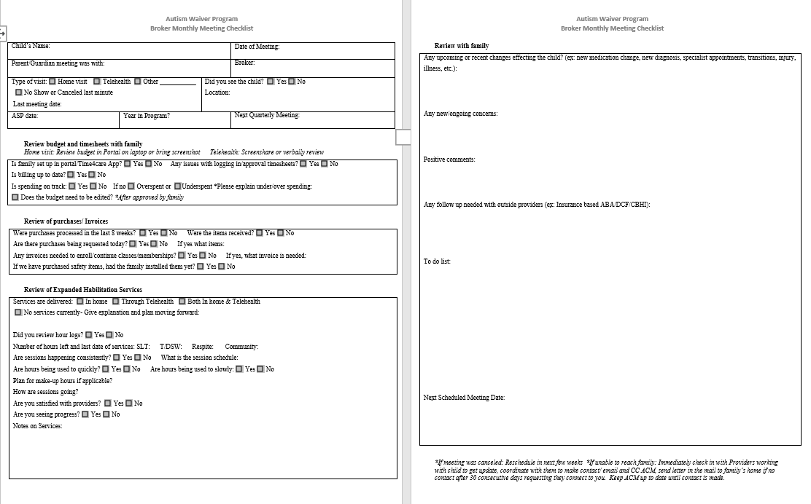
Monthly Checklist will be submitted once a month to ACMs
Designed to be printed on one sheet- front and back
Easy check off boxes with space to capture additional notes

Slide 33
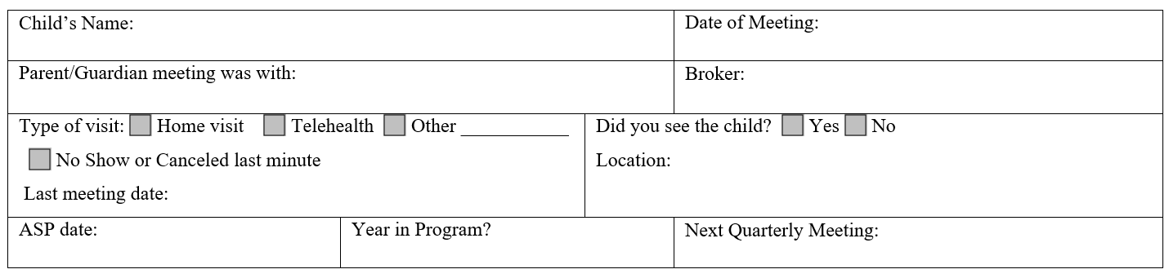
Let’s review the form
First Section
Who, What, Where, When

Slide 34
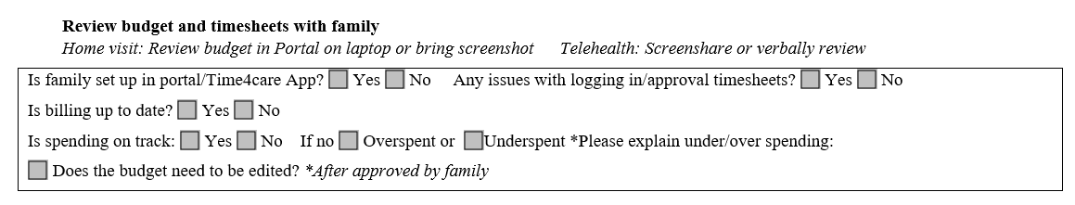
Let’s review the form
Second Section
Budget and timesheets

Slide 35
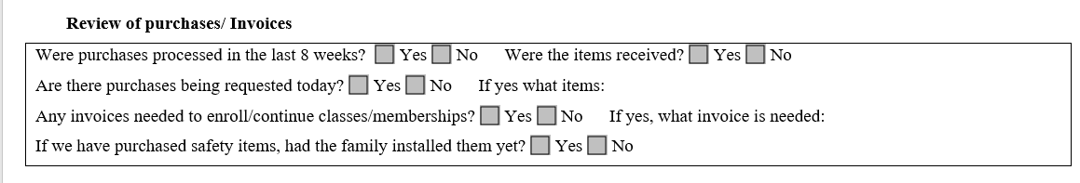
Let’s review the form
Third Section
Purchases and Invoices

Slide 36
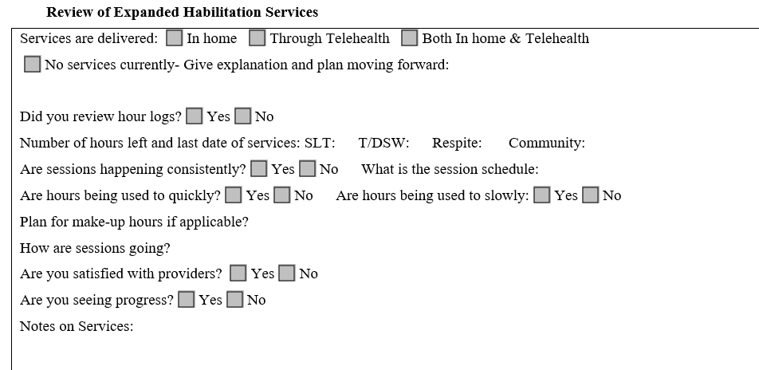
Let’s review the form
Fourth Section
Monitor ExHab Services

Slide 37
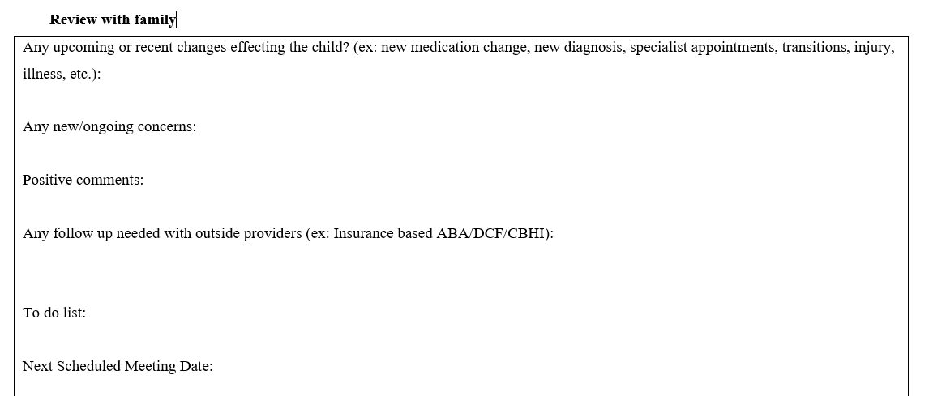
Let’s review the form
Fifth Section
Additional information gathered at meeting
Documenting Follow up needed

Slide 38
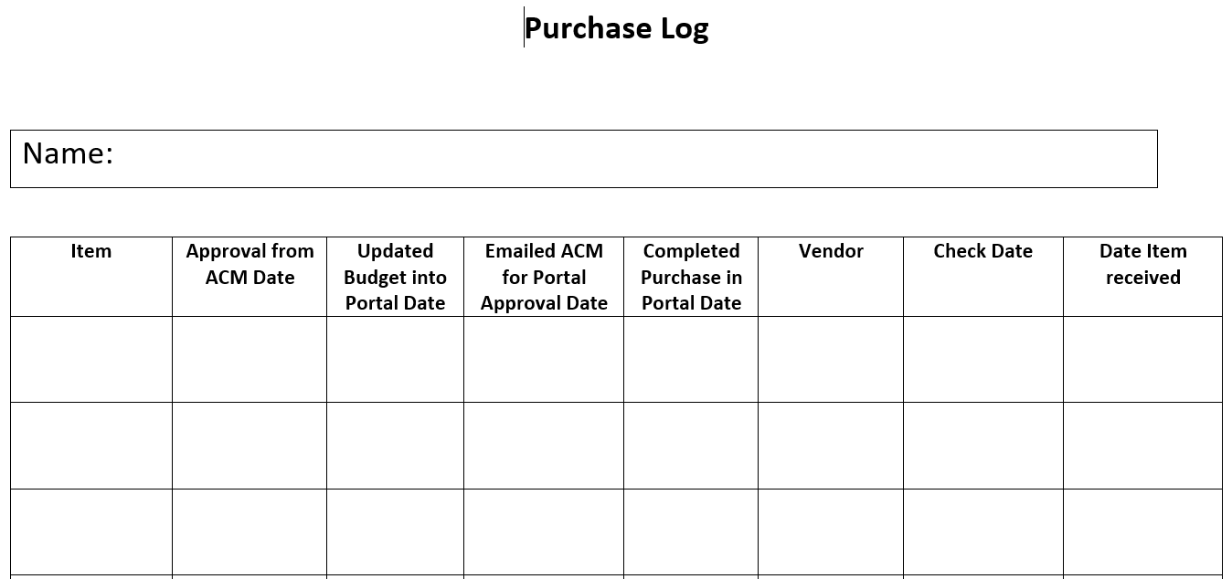
Purchase Log

Slide 39
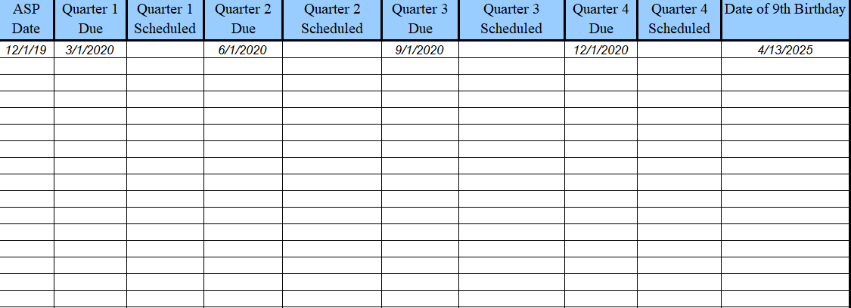
Quarterly Meeting Tracking Form

Slide 40




Suggested talking points and observations for monthly visits:
Personal Well Being
How is everyone doing? Is the family all feeling well?
Are there any physical and/or behavioral changes in child?
Does child appear in overall good health?
Has the child had any recent doctor’s appointments or trips to the ER? Calls to Mobile Crisis?
Have there been any physical changes in caregiver (e.g. weight loss to an unhealthy degree, decline in personal hygiene, bloodshot eyes, etc.)?
Topics that present high level of concern such as potential abuse and/or neglect should be attended to immediately (File 51A, call supervisor/ACM, alert appropriate authority such as DCF and/or 911)

Slide 41




Observations for monthly visits:
Environment Concerns
Are there any obstructed exits in the home?
Are poisons, sharps, firearms stored appropriately?
Are windows secure? Are windows open with no screens?
Any evidence of infestations of any kind?
Do you see any drug paraphernalia like needles, empty alcohol bottles, glass pipes, etc. in the home?
Are smoke detectors in working order? Are they beeping because battery is dead?
How is the overall cleanliness of the home?
Any concerns or anything out of the ordinary about yard or neighborhood?
Any home maintenance issues such as missing ceiling tiles, broken windows, etc.?
Topics that present high level of concern such as potential abuse and/or neglect should be attended to immediately (File 51A, call supervisor/ACM, alert appropriate authority such as DCF and/or 911)

Slide 42

Questions?

Slide 43

Safety Reminders – Home Visits
“Safety is as simple as ABC – Always Be Careful.” – Author Unknown
Notes:
Introduce yourself: Hi, I’m Olivia McGlone, a new Autism Clinical Manger. I started in April and I’m working in the Northeast and Metro Region and today I’ll be completing the Mandated Reporter training about recognizing & reporting Child Abuse, Neglect, and Exploitation.
By a show of hands who is a mandated reporter?
Everyone should be raising your hand, if you are here today, you are a mandated reporter.

Slide 44




Planning for the visit
Traveling to the site
During the visit
Warning / Danger Signs

Slide 45




Plan for the Visit
If possible, schedule visits during daytime hours
Carry a whistle / car alarm activator
Notify your office & the family
Bring a charged cellphone
Obtain specific directions
Notes:
If possible, schedule visits during daytime hours – know when you are going
Carry a whistle on your keychain or carry a car alarm activator when in range of your vehicle.
Notify your office of your destination; provide them with the name, address, telephone number, time and date of visit, & reason for the visit.
Notify your family you are coming and remind them of the purpose of the visit.
Obtain specific directions – know when you are going
Bring a well charged cell phone with preprogrammed crisis numbers

Slide 46

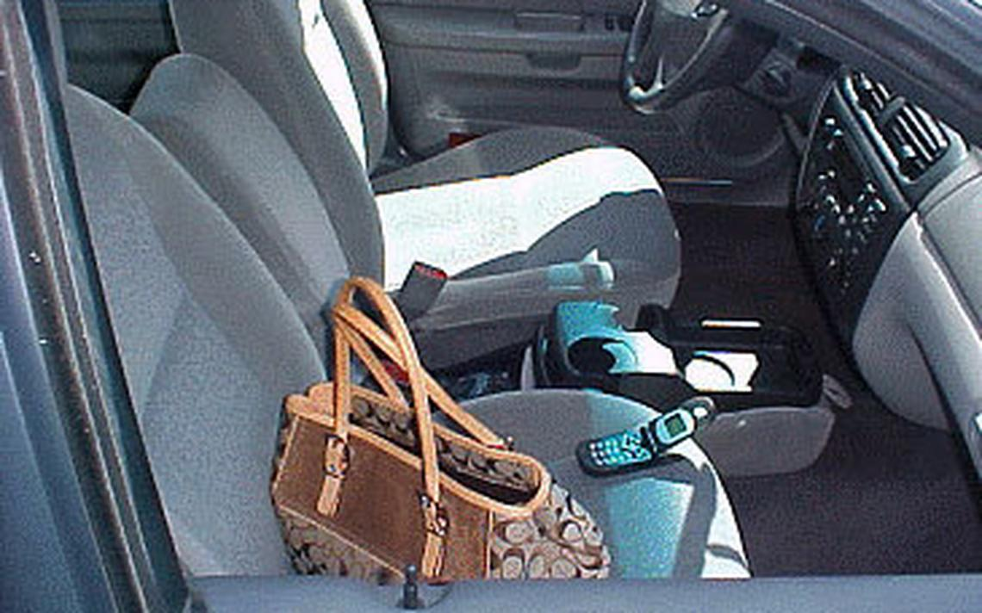


Plan for the Visit
Do not leave valuables visible in your car
Dress appropriately & professionally
Be aware of your personal needs
Share information
Notes:
Do not leave valuables (laptops, wallet, backpacks, etc.) where they are visible in your car.
Dress appropriately and professionally, wearing clothes and shoes that provide freedom of movement; e.g. comfortable shoes, avoid jewelry.
Be aware of your personal needs, limitations, vulnerabilities, etc. (i.e. asthma), be aware of what may trigger them (i.e. cigarette smoke, toxins, mold), and be prepared.
At the program/team level: Be aware of and share information about areas with known safety risks; discuss prevention and safety measures; discuss resources and trainings related to safety; collaborate to go out in teams to unsafe areas.

Slide 47
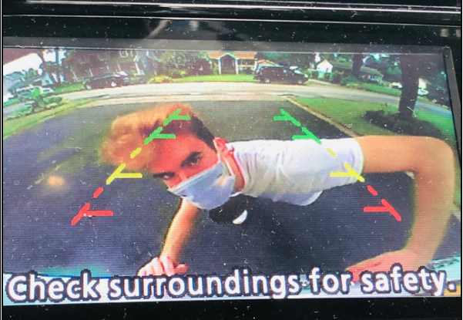

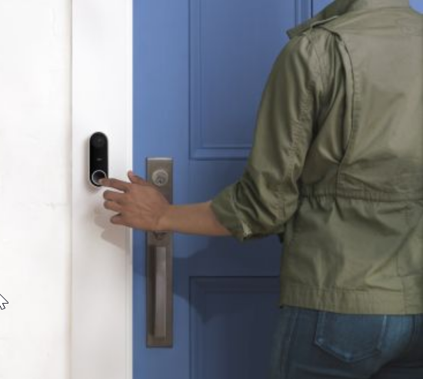
Traveling to the Site
Be mindful of where you park
Visually check your surroundings
Listen to your body language
Knock and use the doorbell
Let yourself adjust to the new environment
Notes:
Visually check the area when you arrive - observe the premises for suspicious activity
Do not leave your car unless you can walk into the building safely. If you are feeling unsafe in the neighborhood, have a family member meet you at your car and then escort you back at end of visit.
Listen to your body language, if you feel unsafe at any time, LEAVE.
Knock and use doorbell. Do not walk into the house unannounced.
Give your eyes a chance to adjust to light prior to entering the building.

Slide 48



During the Visit
Observe / assess others
Understanding cultural awareness and sensitivity
Always wait to be invited to sit
Be aware of all exits
Notes:
Visually check other people who are present during visit (Is anyone under the influence?)
Assess person’s emotional state.
Think about your body language, postures, facial expressions, gestures and tone of voice when talking
Cultural awareness and sensitivity
1.when entering a home whose cultural background may be different than yours, it is important to pay attention to one’s own prejudices and biases, listen to others, ask questions rather than assuming, cultivate knowledge about other cultures
It is important to be respectful of others and accepting people’s opinions, rights and feelings – even when they are different from our own.
Always wait to be invited to sit. Position yourself during visits so you feel comfortable and safe.
Be aware of all exits in the house. Avoid positioning yourself so that you become trapped if you needed to make quick exit.

Slide 49


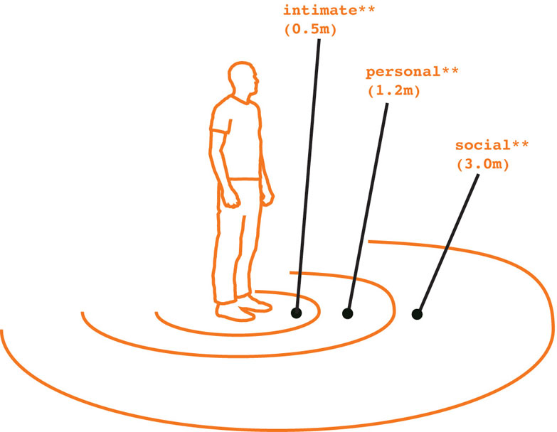
During the Visit
If there are dogs in the house, ask caregiver to remove them
Facilitate a quiet environment
Review the goal of the visit
Respect personal space
Notes:
If there are dogs in house, ask the client to remove them (you can state you have allergies if you need to give a reason).
Ask the client to turn the TV off, (for example saying, “I want to be able to hear you.”).
Restate the goal of the visit and maintain a respectful and courteous attitude.
Respect the individual’s personal space (maintain an appropriate distance).

Slide 50


Warning / Danger Signs
You should not remain in the home if any of the following conditions exist:
Participant or caregiver is intoxicated or under the influence of drugs
Evidence of current active violence domestic dispute in the home
Verbal or physical threats towards the worker
Caregiver states the worker is not welcome
Notes:
You should not remain in the home if any of the following conditions exist:
Client or parent is intoxicated or under the influence of drugs.
There is evidence of current active violent domestic dispute in the home.
Actual violence is exhibited toward the worker.
An actual threat is made against the worker.
Any sexual threats or advances are made toward the worker.
The client states the worker is not welcome in the home.

Slide 51

Remember to follow your ABC’s -
Always Be Careful
If staff feel there is an imminent danger to themselves or anyone in the home, they should leave immediately.
After leaving, staff should immediately call 911.
If there are concerns about the safety of the child, the local Department of Children and Families (DCF) should be notified.
Notes:
When visiting a home in the community staff should leave immediately if they feel there is an imminent danger to themselves or anyone in the home. After leaving the home staff should immediately call 911. If there are concerns about the safety of a child in the home, the local Department of Children and Families (DCF) should be notified. Staff should also contact their supervisor to discuss the situation and develop a plan of action. Upon return to the office, staff should ‘debrief’ with their supervisor regarding what was observed during the visit.
As always Department of Developmental Services Autism Clinical Manager should be notified about the safety of a child in the home.

Slide 52


Slide 53
EMERGENCY FACT SHEET
UPDATES

Slide 54
UPDATES
ASP renewal date and date form was completed
Highlights primary residence
Added section for Dentist and Hospital affiliation

Slide 55
UPDATES
List of allergies
Expanded medication section to include dose and frequency and reason for prescription
Question about Safety Net Device
Switched out the “situation section” for a section about safety and challenges
Picture –attach updated picture annually with specific written permission and release from family

Slide 56
Supervisor Tracking Form

Slide 57
Supervisor’s Role
When the Waiver RFR was approved, this gave us the opportunity to strengthen the Broker Supervisor’s role in many of the Centers, allowing them to be able to focus on the Waiver Program. This dedicated position allows for additional support to the Brokers and time to focus on training needs and other issues that might come up when working with our families.
Also, with this opportunity, came new reporting requirements and oversight from CMS, our funding source, to track and provide data for Quality Assurances. This information can be requested by CMS as part of an audit of the program. The supervisor’s role has become more defined as an agent to assist with these quality assurances in order to maintain program integrity and to insure we are providing a high quality of care to our Waiver participants.

Slide 58
The Supervisor’s role is tied directly to these QA Measures. Duties include the following:
Attend the monthly ASB/ACM meetings for their support center.
Outreach with community providers in order to become knowledgeable about local resources.
Cover for broker absences and vacancies and be able to execute all broker tasks and responsibilities.
Track timelines for quarterly meetings and ASP renewal dates/meetings.
Track in person visits and whether the child was present.
Monitor monthly Meditech notes and participant files for quality and accuracy.
Attend a percentage of quarterly meetings on a regular basis with each of the support brokers.
Have a working knowledge of the PPL portal and processes.
Ensure a firewall between the Waiver Program and the Organization to avoid conflict of interest.
Respond to Autism Clinical Manager inquiries in a timely manner (and within 24 hours or less in case of an emergency).

Slide 59
Monthly and Quarterly Meetings Number of children on broker caseload: Number of families who received a monthly face to face visit: Number of families who did not receive a face to face meeting: List each family and why: Number of meetings supervisor attended this month: List meetings attended: Broker completed monthly meeting tracking form for each visit: Yes No Broker keeps meeting tracking form up to date: Yes No

Slide 60
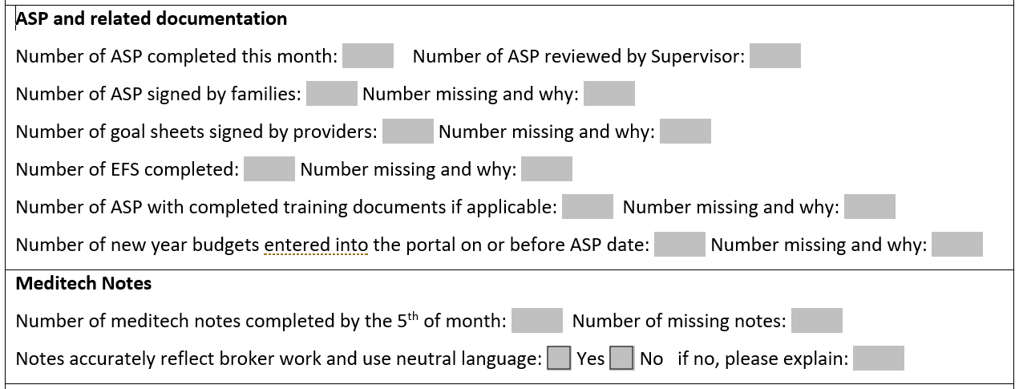

Slide 61
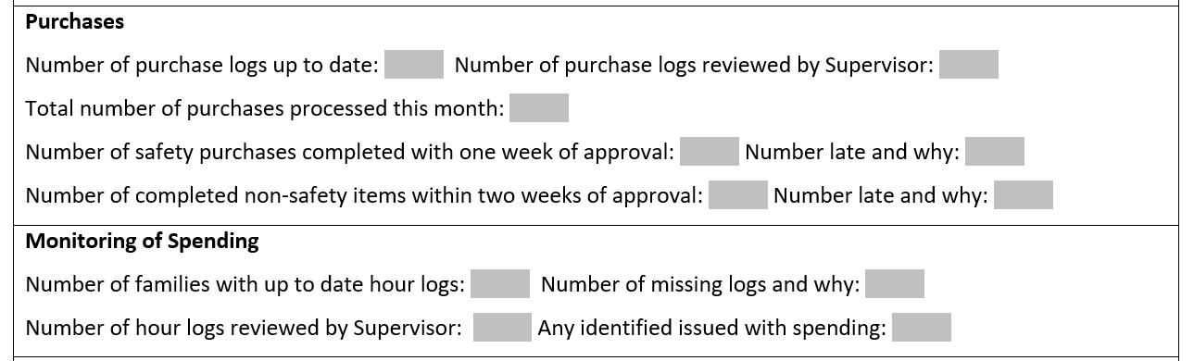

Slide 62
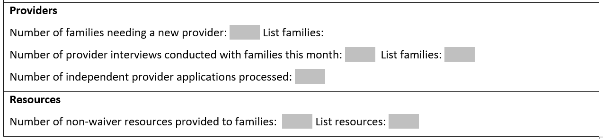

Slide 63
Questions?

